Slide 1
Ferroelectric Capacitance and Current Measurement System
Milestone 2

Slide 2

Group ID - MON-03
Project ID - P22
Team Members -
Madhav Gupta (21d070043)
Pranav Jain (21d070049)
Krisha Shah (21d070039)
Dhrumil Lotiya (21d070026)
Link: Documentation of progress, plan of action and all problems and solutions

Slide 3
Summary of Progress in last milestone
Components selected and justified for Ferroelectric Capacitance system, including microcontroller, DAC, and power diodes, ensuring compatibility with project requirements.
Testing plan outlined for component integration and functionality verification, with a focus on circuit design, PCB fabrication, and microcontroller programming.
Risk assessment conducted, mitigation strategies defined, and work distribution among team members established for efficient progress towards project milestones.

Slide 4
Feedback from last Milestone
We required enhancement in engineering discernment. While most principles and assumptions were correctly applied, we sometimes overlooked minor details. For instance, the specific current values when applying a triangular voltage waveform to a capacitance of a particular value.
We resolved this challenge through simulations, which allowed us to thoroughly examine and understand the behavior of the system under different conditions.

Slide 5
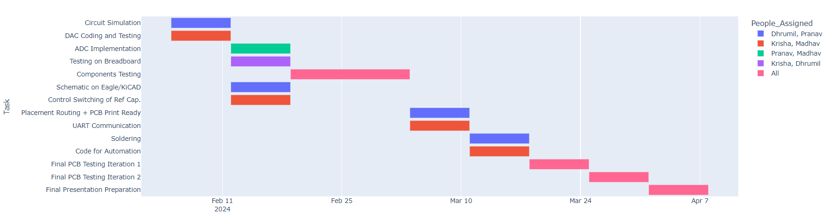
Previous Project Management Plan

Slide 6
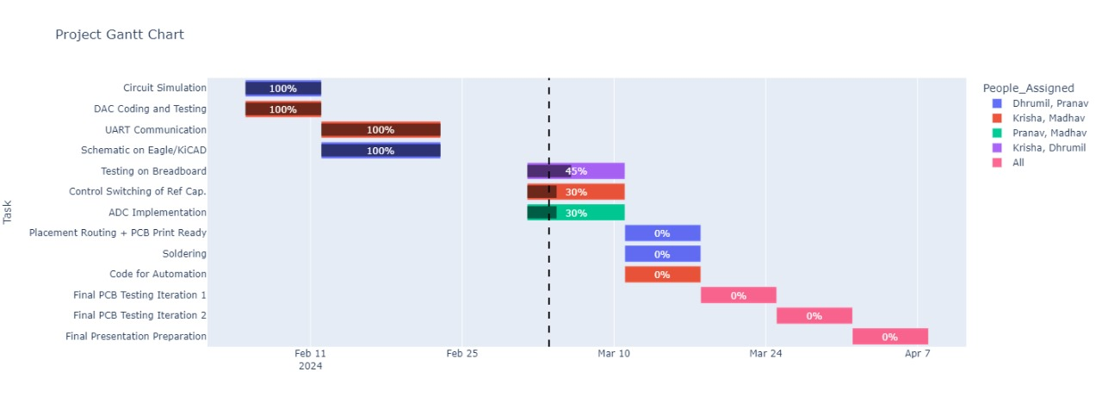
Updated Gantt Chart

Slide 7
We completed UART communication before ADC Implementation as UART can be used to transmit digital data (such as the digital values obtained from an ADC) to the microcontroller.
The parts needed to test few of the sub-circuits from the original circuit have not been delivered yet.
We have thought of an approach to Control Switching of Reference Capacitor but are yet to test it.
Deviations from Original Plan

Slide 8
Control Switching of Reference Capacitor
Designing a circuit where the MOSFET is connected between the capacitor and the ground. This configuration allows the MOSFET to effectively switch the connection of the capacitor to the ground.
Connect the gate of the MOSFET to a GPIO pin of the microcontroller through a current-limiting resistor. This resistor protects the microcontroller from excessive current flow when charging and discharging the gate capacitance of the MOSFET.
Connect the capacitor between the MOSFET drain and the positive supply voltage (VDD).
Configure the GPIO pin connected to the MOSFET gate as an output in the microcontroller initialization routine.
Implement safety features such as flyback diodes or voltage clamping to protect against voltage spikes or reverse currents.

Slide 9
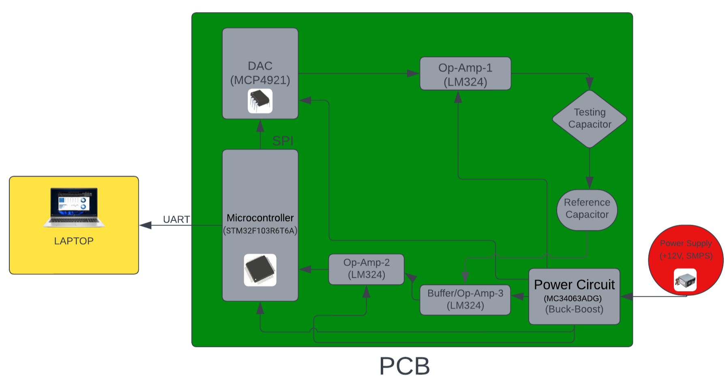
Block Diagram

Slide 10
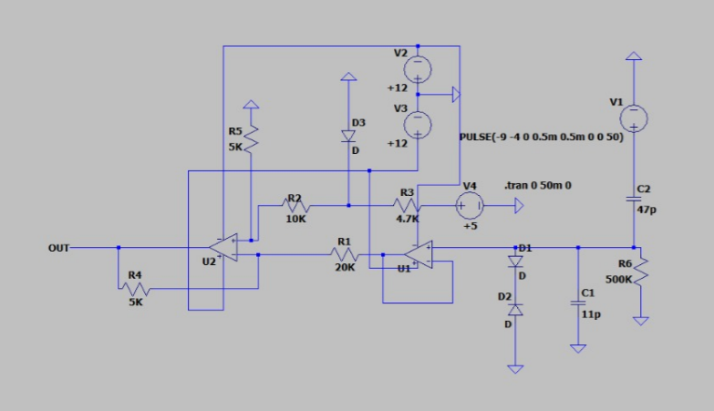
Circuit Simulations & Analysis
Overall circuitry of the system:
OUT signal goes to Microcontroller. C2 is the reference capacitor here which will be replaced with actual capacitor whose capacitance has to be tested.
All the supply voltages(V1, V2,etc.) are given from Buck boost power supply (SMPS) .

Slide 11
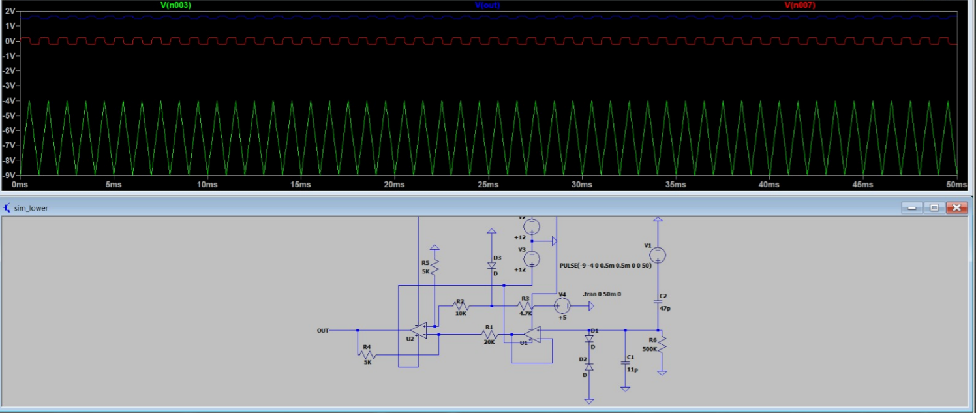
Simulations Result
Circuitry for lower half(i.e., for functioning of Opamp-2 and connected components:

Slide 12
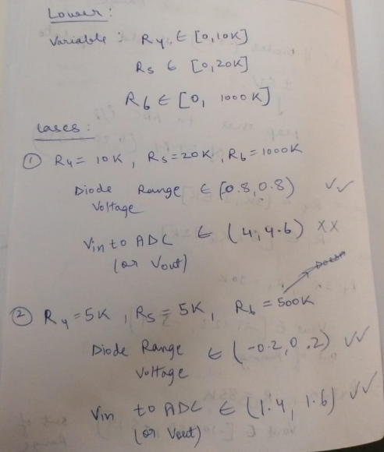
Analysis and Calculations
In the above circuit;
Green- V1 (triangular waveform across capacitor), Red - Voltage regulated by diodes, Blue - output voltage (input to ADC)

Slide 13
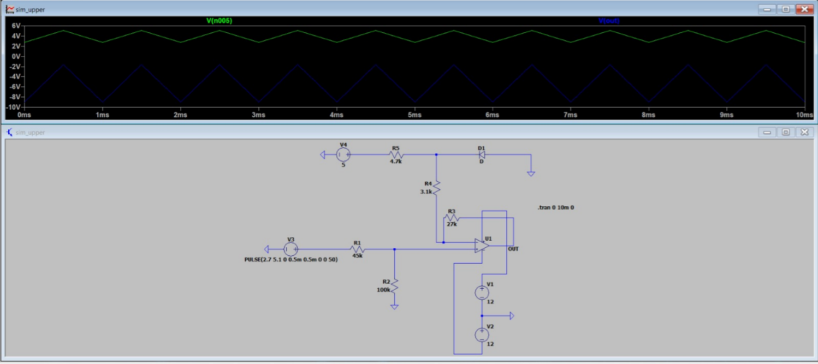
Simulations Result
Circuitry for upper half i.e., for functioning of Opamp-1 and connected components:

Slide 14
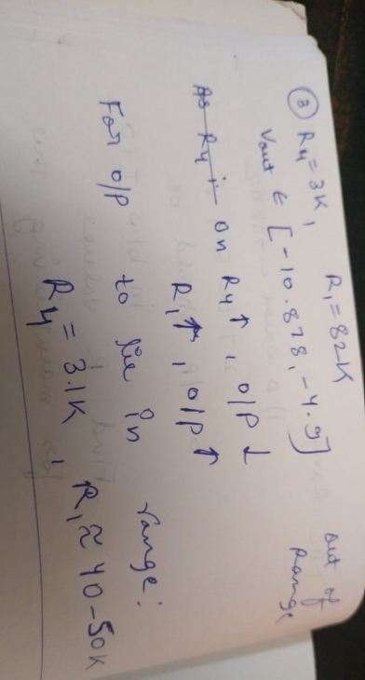

Analysis and Calculations
For the upper circuit, Blue- V3 (output of DAC), Green - Output (waveforms across testing capacitor )

Slide 15
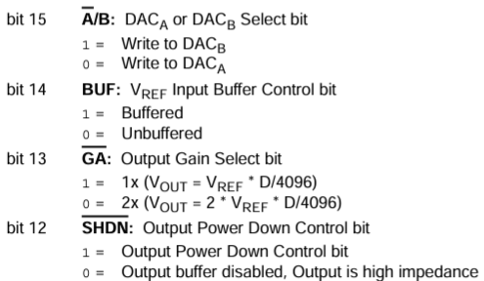
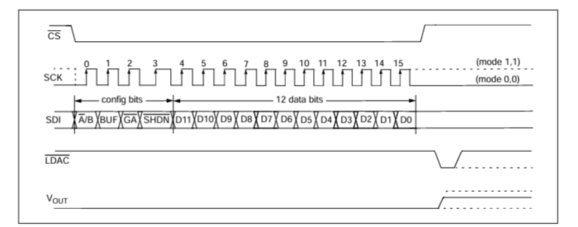
DAC(MCP4921) Coding and Testing
The 1st 4 bits to send in MCP 4921 are displayed in the figure below. For MCP4921 only DACa is applicable and for DAC testing we sent 0011 as the 1st 4 bits i.e. keeping the Output Gain as 1 and Output Power down
The other pins in MCP 4921 IC are configured according to the diagram below to facilitate digital data transfer from the STM 32 board to the DAC(MCP 4921)

Slide 16
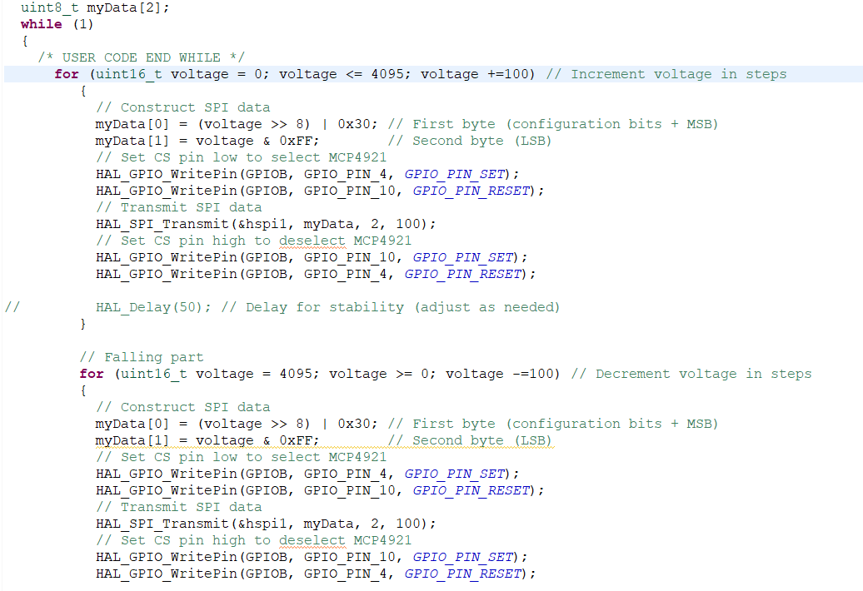
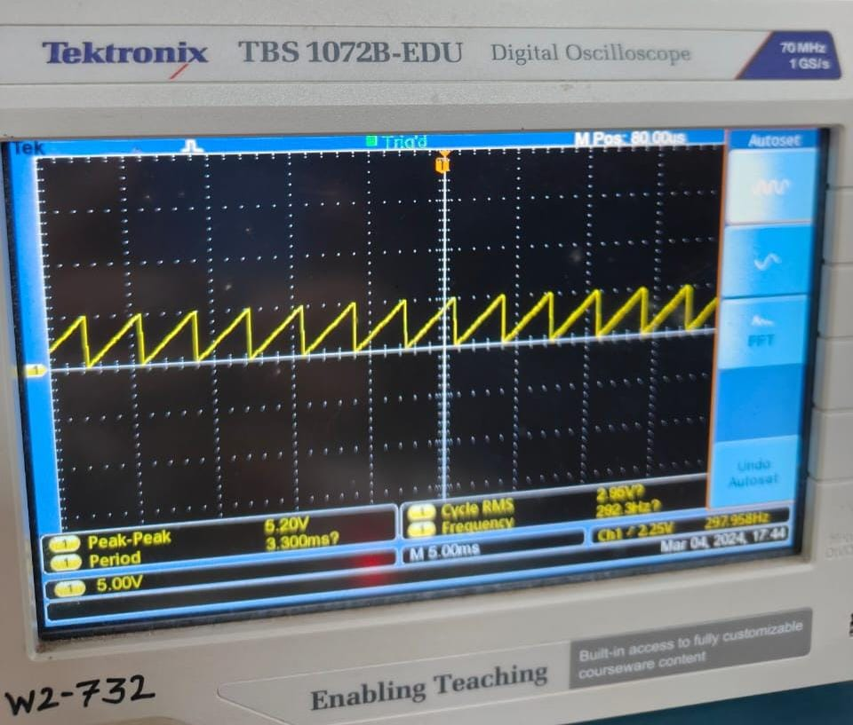
DAC(MCP4921) Coding and Testing
As the DAC has 12-bit
resolution so minimum
count is 5V/2^12 = 1.22mV
Below is the code to
generate the triangular wave
so here voltage rises in steps of
0.12V starting from 0 to 5V and
then decreases with the same
step size to 0V

Slide 17
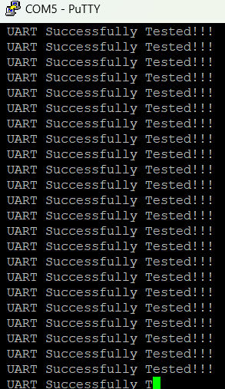
UART Testing for Data Transmission
Tested the data transmission from STM 32 to the
laptop through UART
Used the Putty terminal and real-term software to
display the data that is being sent from the
microcontroller to the laptop
Code in STM32 IDE
uint8_t Test[] = " UART Successfully Tested !!!\r\n";
//Data to send
HAL_UART_Transmit(&huart2,Test,sizeof(Test),20);
// Sending in normal mode

Slide 18
ADC Testing(using in built ADC of STM)
Currently testing the ADC of the micro-controller
with the help of UART
Trying to print the digital values on the Putty
Terminal after giving analog input to the ADC pin
Current Code in STM32 IDE
HAL_ADC_Start(&hadc1);
// Wait for ADC conversion to complete
HAL_ADC_PollForConversion(&hadc1, HAL_MAX_DELAY);
// Read ADC value
uint8_t adcValue = HAL_ADC_GetValue(&hadc1);
// Transmit ADC value over UART
HAL_UART_Transmit(&huart2, (uint8_t *)&adcValue, sizeof(adcValue), HAL_MAX_DELAY);

Slide 19
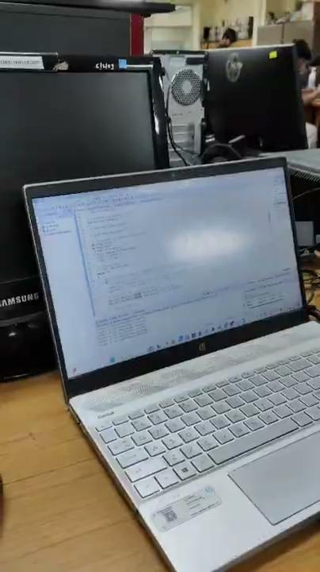
INITIAL TESTING
Follow the link in the graph to modify its data and then paste the new one here. For more info, click here

Slide 20
TESTING PLAN
We will test the components on breadboard and then make small circuits like done above in simulation(upper half opamp circuit and lower half opamp circuit)
Then we will see if there is any issue with our approach and resolve it if found.
Final testing involves replacing given test capacitor with different value of capacitor and give 3 types of triangular pulses as input : 1) single triangular wave, 2)Consecutive triangular wave and 3) Series triangular wave.
Here purpose of 3rd type of input is to just make sure that capacitor does not breakdown; we don’t measure anything in the output for this.

Slide 21
Future Milestone :
Software development and test automation relevant to project
Implementing test automation scripts to conduct a series of three tests on the system, enabling automated data collection and analysis.
Integrating graphical visualization tools to present test data in diverse formats for easy interpretation and analysis, enhancing the user experience and system efficiency.
Follow the link in the graph to modify its data and then paste the new one here. For more info, click here

Slide 22
Future Milestone
Key engineering design considerations for assembling prototypes:
PCB Layout Optimization: Ensure efficient placement of components on the PCB to minimize signal interference and optimize circuit performance.
Signal Integrity: Maintain signal integrity by adhering to proper routing techniques, minimizing signal distortion, and ensuring impedance matching.
Test Points and Debugging Features: Include test points and debugging features in the design to facilitate troubleshooting and testing during the assembly and prototype validation phase.
Follow the link in the graph to modify its data and then paste the new one here. For more info, click here

Slide 23
References
Nucleo Board Mapping for STM32 IDE
Reference for sending bits in DAC using SPI
Datasheet of DAC(MCP4921)
Follow the link in the graph to modify its data and then paste the new one here. For more info, click here

